Slide 1



Amazon Best Selling Books Analysis Using Machine Learning

Slide 2
Group members
SUPERVISED BY
NAME
ID
DR. ASHRAF UDDIN
Assistant Professor, CS
AMERICAN INTERNATIONAL UNIVERSITY-BANGLADESH
MD. TANVIR RAHMAN MOLLA
MD. REZWAN MUJAHID RUDRO
22-46052-1
22-46802-1

Slide 3

Introduction
What is the Project About?
Analyzing Amazon’s bestselling books to identify trends, patterns, and success factors.
Using machine learning to predict future bestsellers and derive actionable insights.
Why This Topic?
Amazon is a dominant book retailer; understanding success factors benefits authors, publishers, and readers.

Slide 4
OBJECTIVES
Identify trends in bestselling books.
01
Predict books likely to become bestsellers.
02
Analyze user sentiments and reviews.
03
Provide personalized recommendations.
04

Slide 5
Problem Statement
Identifying Success Factors
Predicting Bestseller Potential
Customer Review and Sentiment Analysis
Seasonality and Trend Analysis
Segmentation of Bestselling Books

Slide 6

methodology
Dataset Description
Source
bestsellers with categories.csv
Features
Book Name, Author, User Ratings, Reviews, Price, Year, Genre

Slide 7
METHODOLOGY
Machine Learning Algorithms
Chosen Machine Learning Algorithms
Linear Regression
Logistic Regression
Random Forest
K-means Clustering
Decision Tree

Slide 8
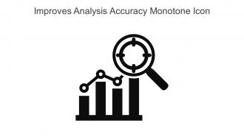
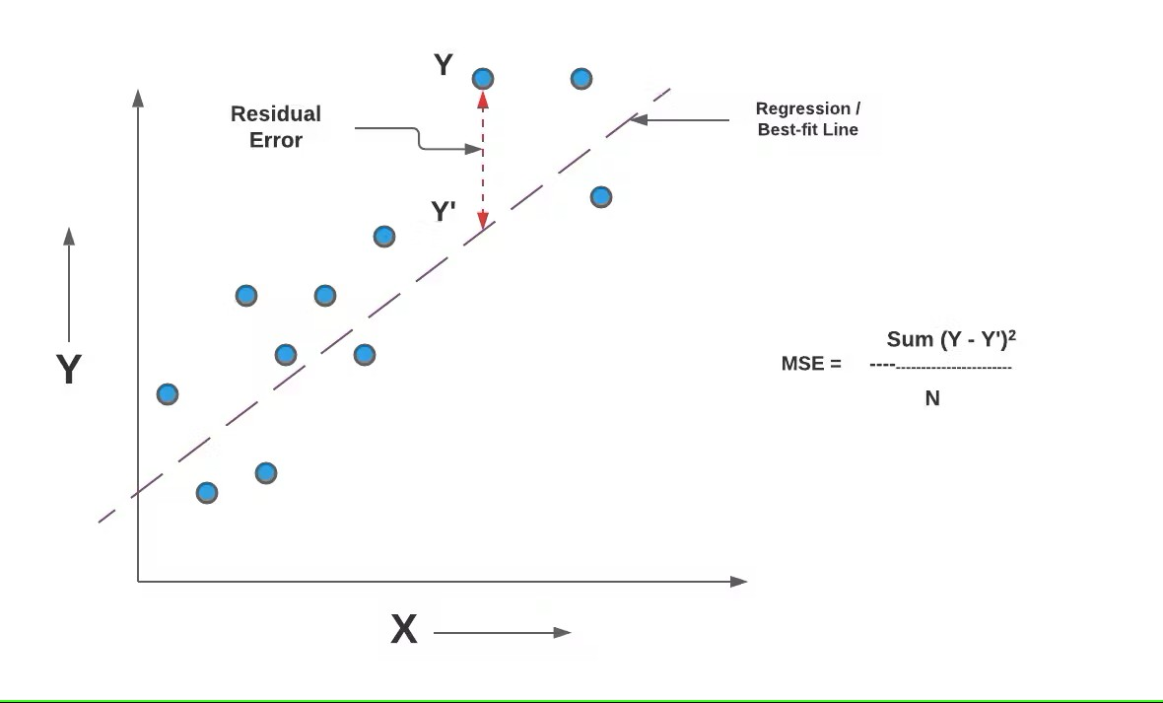
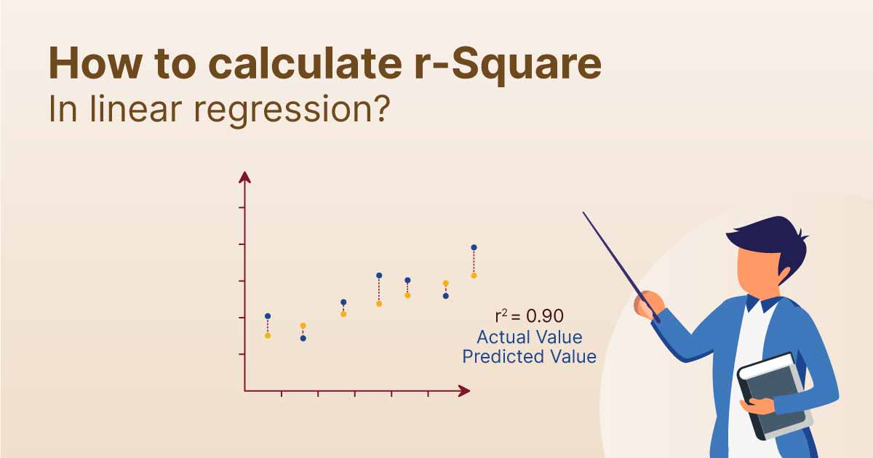
Methodology
Application of Evaluation Metrics
Accuracy
Mean Square Error
R-square Value

Slide 9
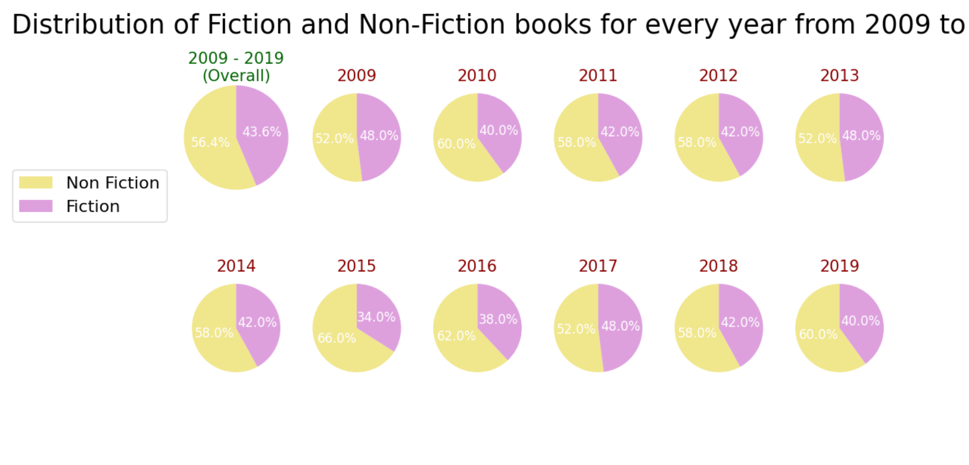
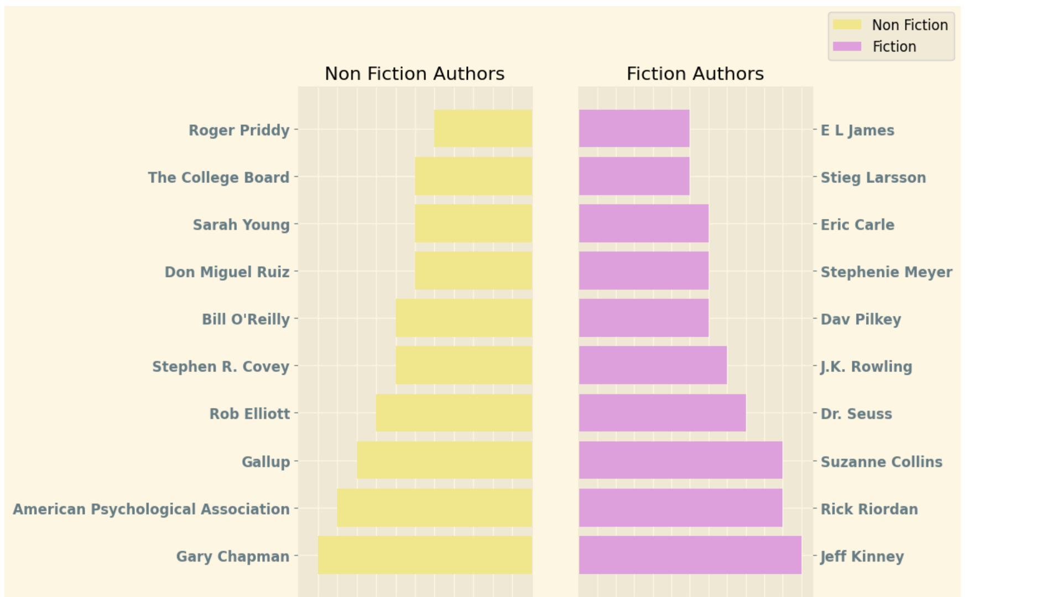
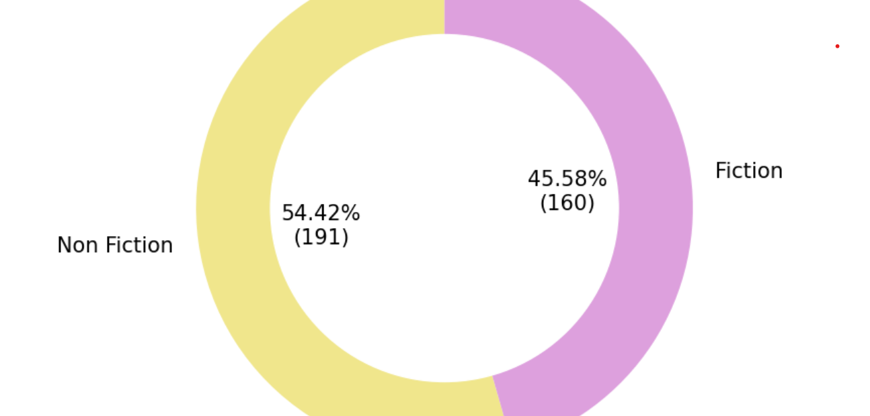
Data visualization

Slide 10
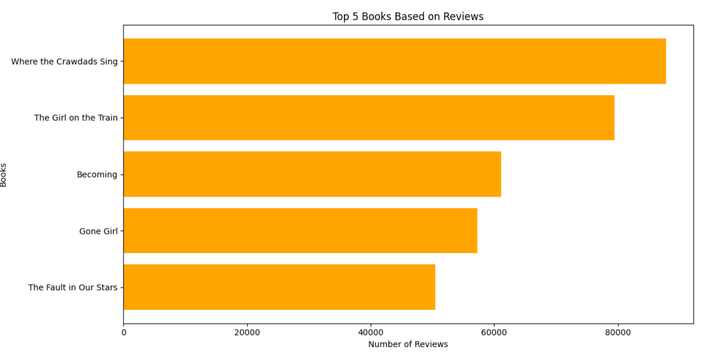
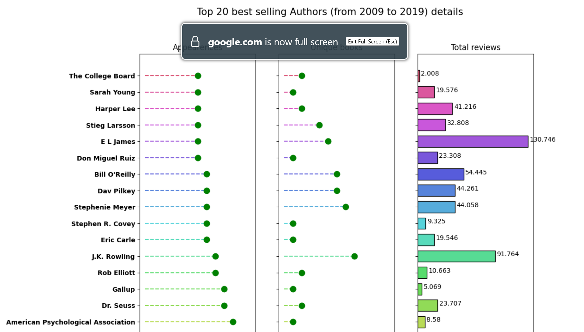
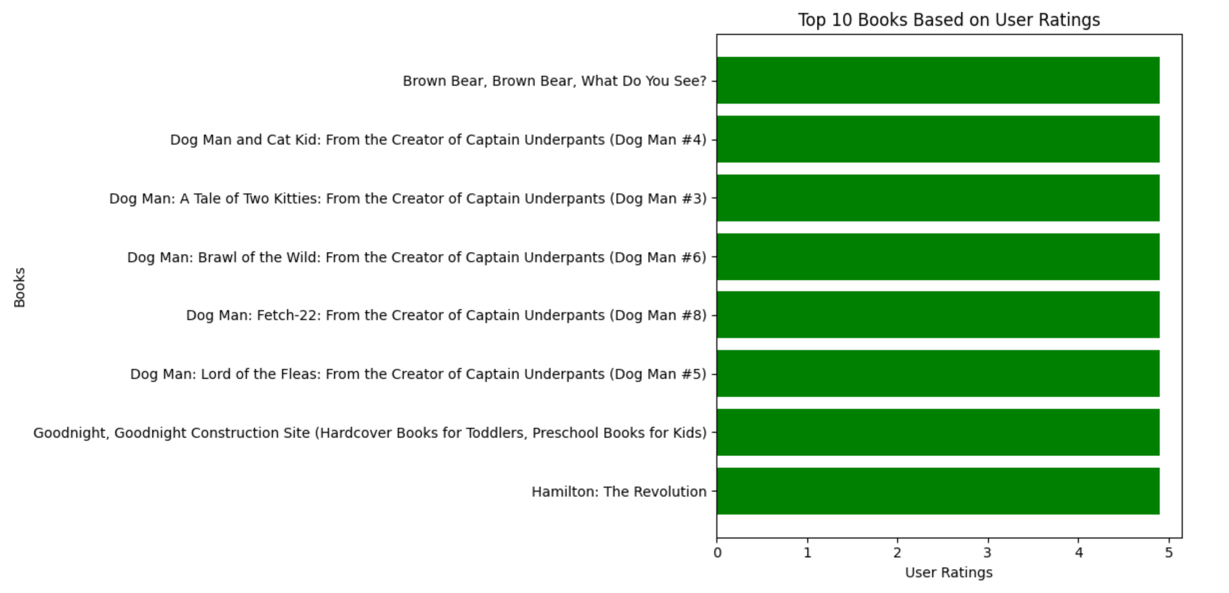
Data visualization(contd.)

Slide 11
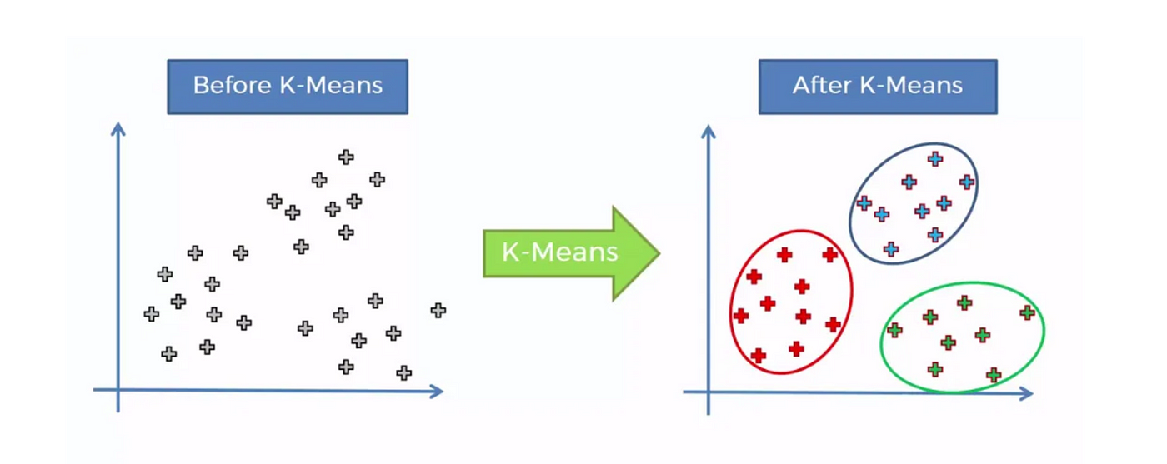

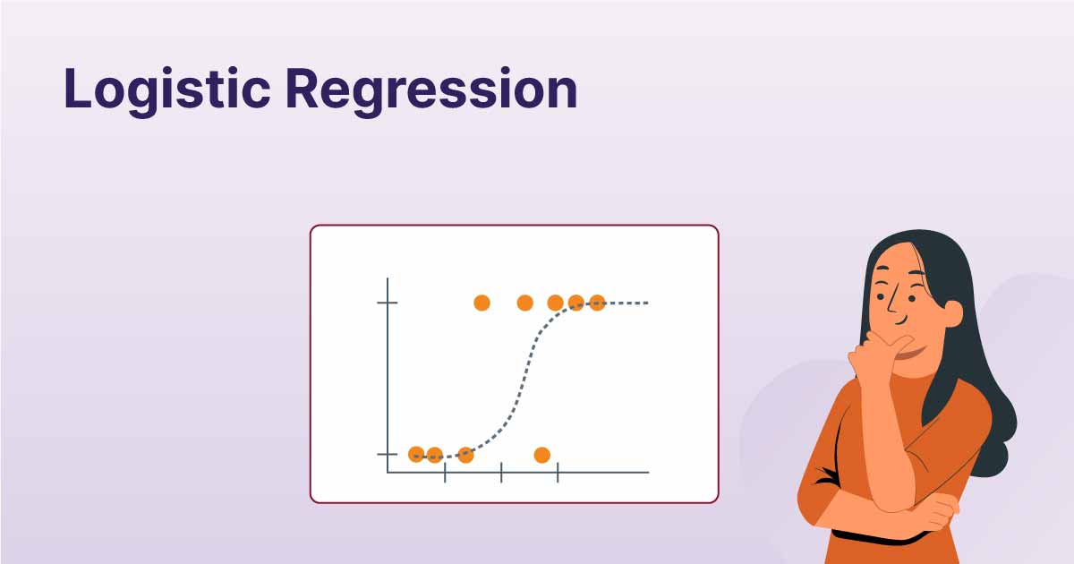
Models Used
Clustering
Group books by similar attributes (K-means)
Predictive Models
Predict sales rank based on numerical features like price, ratings, and reviews
Classification for determining bestseller status (e.g., Logistic Regression, Random Forest).

Slide 12
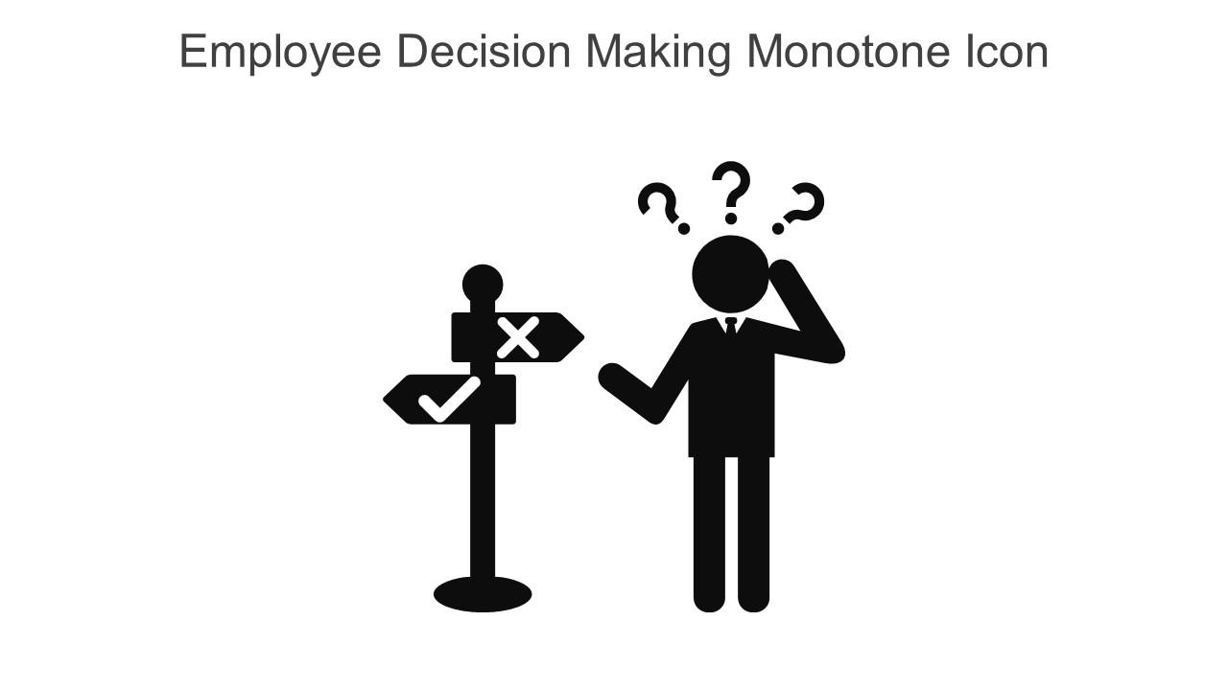
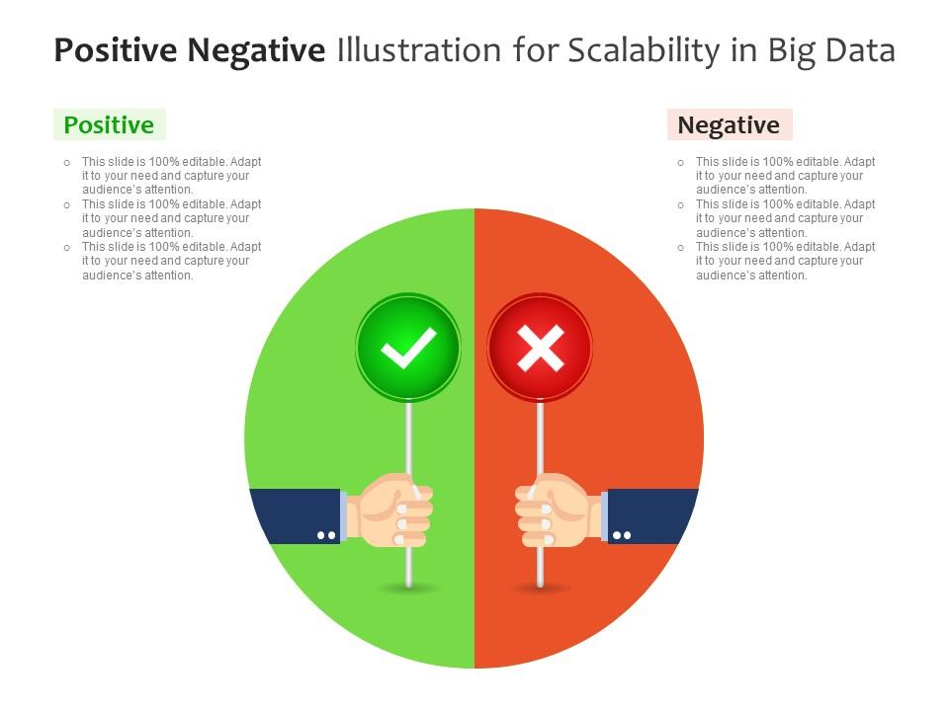
Why These Models?
Accuracy: Tailored to the specific type of prediction or analysis required.
Interpretable: Provides actionable insights for decision-making
Scalability: Can handle large datasets with diverse features

Slide 13
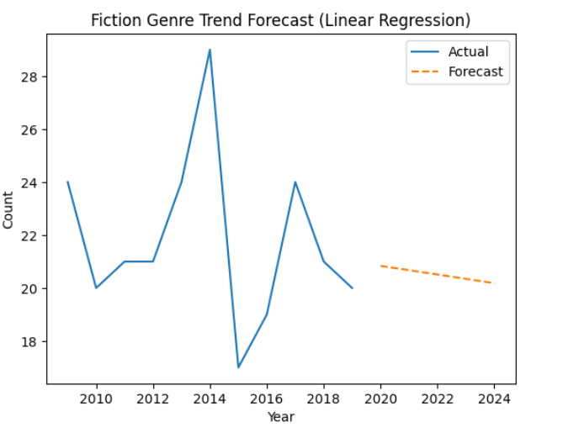
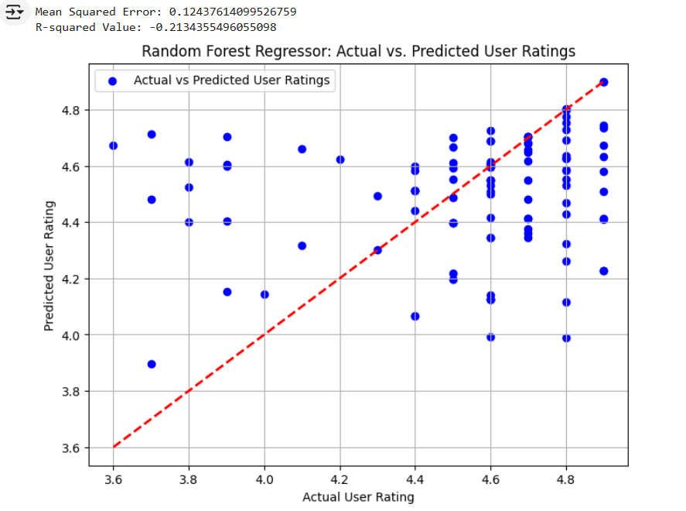
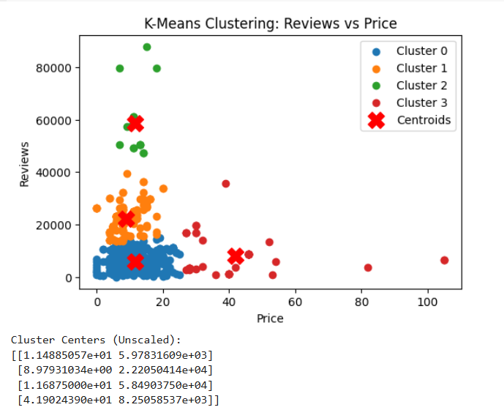
Results
Sales Rank Prediction
Bestseller Classification
Regression model achieved high accuracy in predicting sales rank
Identified trends: Genre Trend Forecast (Linear Regression)
Clustering Insights
Logistic Regression achieved an accuracy
Random Forest outperformed with an accuracy
K-means grouped books into N clusters based on reviews, price, and rating
I

Slide 14
Discussion
Model Performance
Challenges and Limitations
Key Findings
Positive customer reviews and high ratings strongly influence sales rank and bestseller status
Pricing strategy plays a critical role in determining a book's market success
Predictive models provided accurate and actionable insights
Random Forest outperformed Logistic Regression
Clustering revealed meaningful customer segments for targeted marketing in classification
Data Quality: Missing or inconsistent data in reviews and ratings
Feature Selection: Some variables (e.g., genre) had less predictive power

Slide 15

Live Demo in Google Colab
https://colab.research.google.com/drive/1LuFNM90Bahyb5nUhMG1wBEYFfQ_r9DiQ?usp=sharing

Slide 16


